Slide 1

Software Engineering
Project: SMART COMMUTE WEB APP
Antonio Michele Del Negro -862516
Pável Pascacio De Los Santos-852255
Prof. Matteo Rossi
May, 2019

Slide 2
Smart Commute
Smart Commute is a web-based application that aims to make the user’s appointments scheduling easier by considering the time it takes to go from one place to another through integrated geolocation API’s. In addition, within the same application it saves the appointments’ addresses and durations and shows the best way to get from one place to another, warns you if there’s no time, and helps coordinate efficiently.

Slide 3
Software Development Life Cycle of Smart Commute
Feasibility study
Requirements Analysis & specification
Design
Coding & Unit Test
Integration & System Test
Deployment
Maintenance

Slide 4
Outline
1. Smart Commute Overview
2. Idea
2. Objective
3. Requirements
3.1 Use Case Diagram
3.2 Requirements
3.3 System Architecture
4. Design
4.1 High Level Class Diagram
4.2 Front-end Class Diagram
4.3 Back-end Class Diagram
4.4 Sequence Diagrams
4.4.A Log in and Load data to the App Environment
4.4.B Create an Event
4.4.C Modify and Delete an Event
4.4.D Select an Event on the Map
5. Implementation
5.1 Graphical User Interfaces
5.2 Used Tools and Code description
6. Testing
7. Conclusion and Future Works
Outline

Slide 5
Smart Commute Overview - Motivations
Work routines in big cities increasingly hectic and dynamic: several markets and industries demand quick and varied work routines
Encouragement to focus on what’s important and prevent user procrastination on smartphones
Motivation to develop browser native applications on a potential market: native web OS for smartphones (successful in India -> Kai OS)
Maximization of compatibility by using web based app: available to use in virtually any smart device, which means use in any kind of environment.
Smart Commute Overview

Slide 6
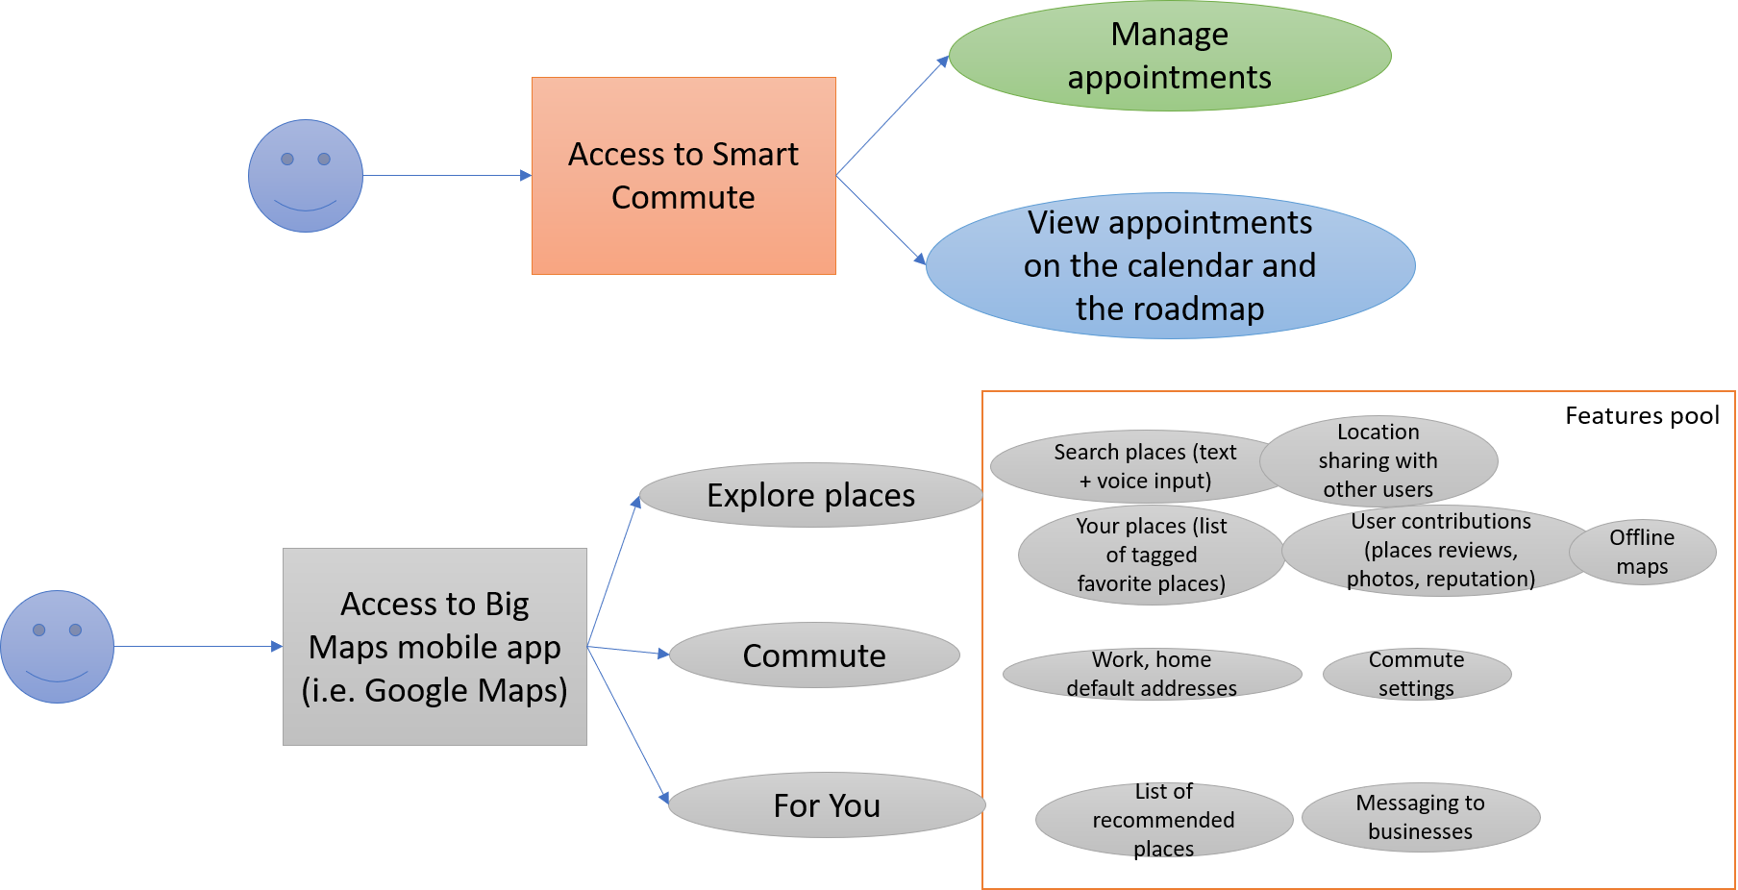
Idea
Dedicated app
Less functionality versus other mapping applications
Less audience, more focus on a specific feature
Focus on time optimization
Idea

Slide 7
Who?
Why?
In the market there is a wide variety of apps that provides a generic schedule and travel routing services, but any app is focused on a specific and ad hoc work environment.
The user will find an easy environment that met his needs to schedule events considering the geographical location managing the travel’s times to avoid collision between them
The App will be runs in any web browser , which permits to use the app in different operative systems and devices.
Architecture?
anybody who must go from one place to the other every workday and attend meetings or errands
What utilities provide?
It integrates a fully functional calendar with a mapping API and a routing API and uses a crafted algorithm to show in real time where and when to go according to the user’s plan of the day
Smart Commute
Idea

Slide 8
Objective
Provide a scheduler web-app with a calendar interface that computes and accounts for travel time between appointments to make sure you are never late for an appointment.
Objective

Slide 9
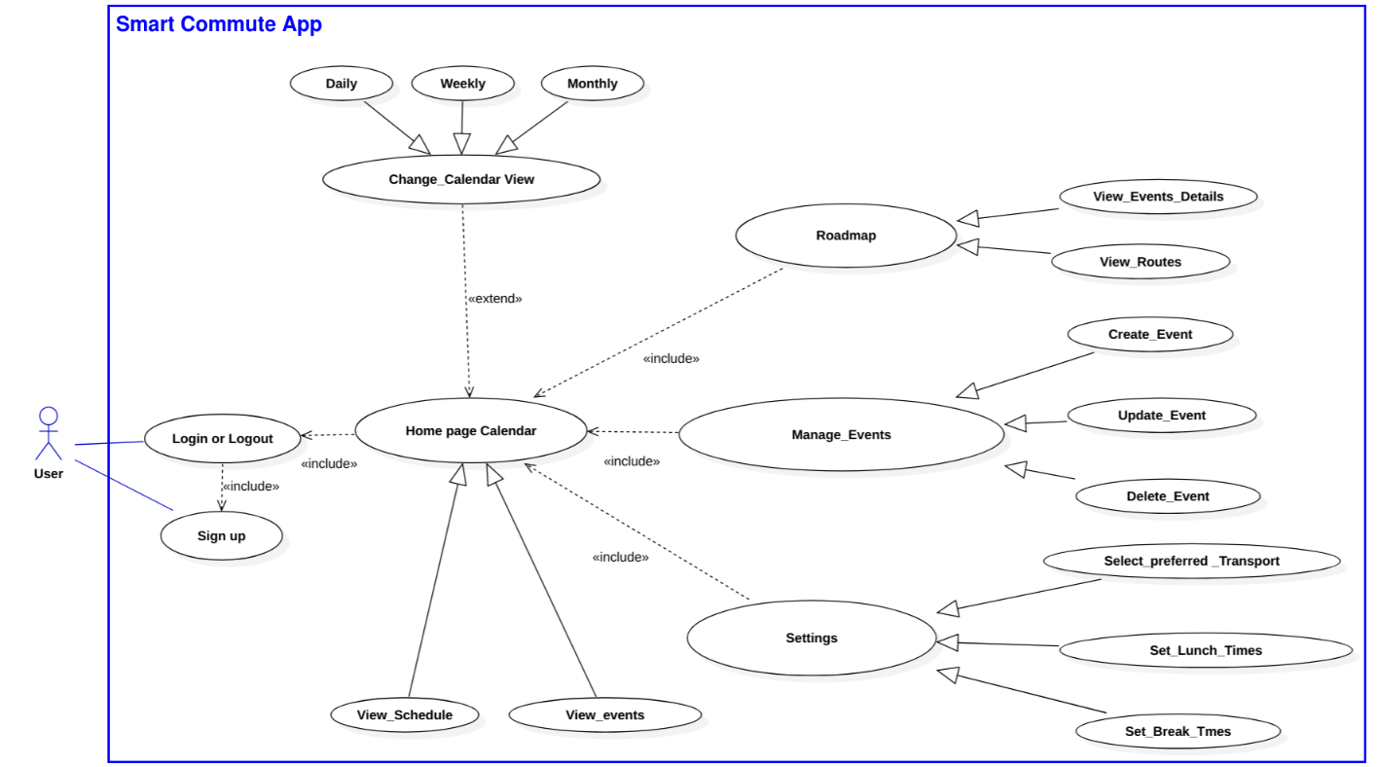
Use Case Diagram
Requirements

Slide 10
Requirements
User authentication
Calendar
Roadmap
User Setting
Smart Commute
Requirements

Slide 11
User authentication
The app will allow the user to access Smart Commute using an account
The app will permit multi-user access
The app must communicate with the database to interact with each user’s data
Requirements

Slide 12
Calendar
The app must provide a Calendar Interface that shows the user’s events and permits the user to interact with them
The calendar must provide a graphic representation of all user events
The calendar must provide a form popup to manage the events
The calendar must store and update the user’s events in the Database
Requirements

Slide 13
Roadmap
The Roadmap will have a map and a daily calendar of the current events
Requirements

Slide 14
User Settings
The app will provide a settings menu that allows the user to modify the preferences
Requirements

Slide 15
Smart Commuting
The Smart Commute must compute and validate time of the events
The Smart Commute must account for travel times for event validation
Requirements

Slide 16
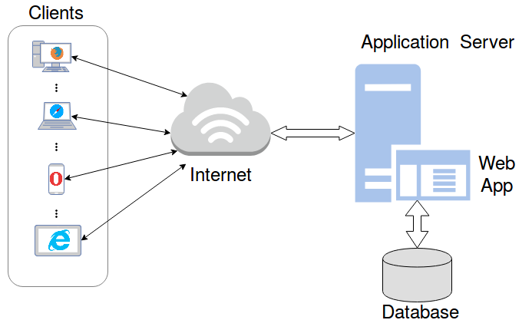
System architecture
Requirements

Slide 17
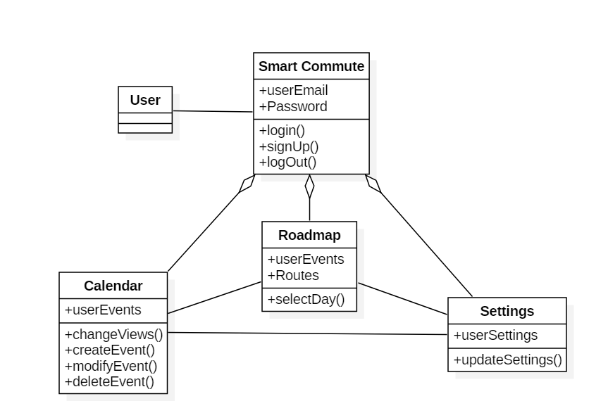
High Level Class Diagram
Design

Slide 18
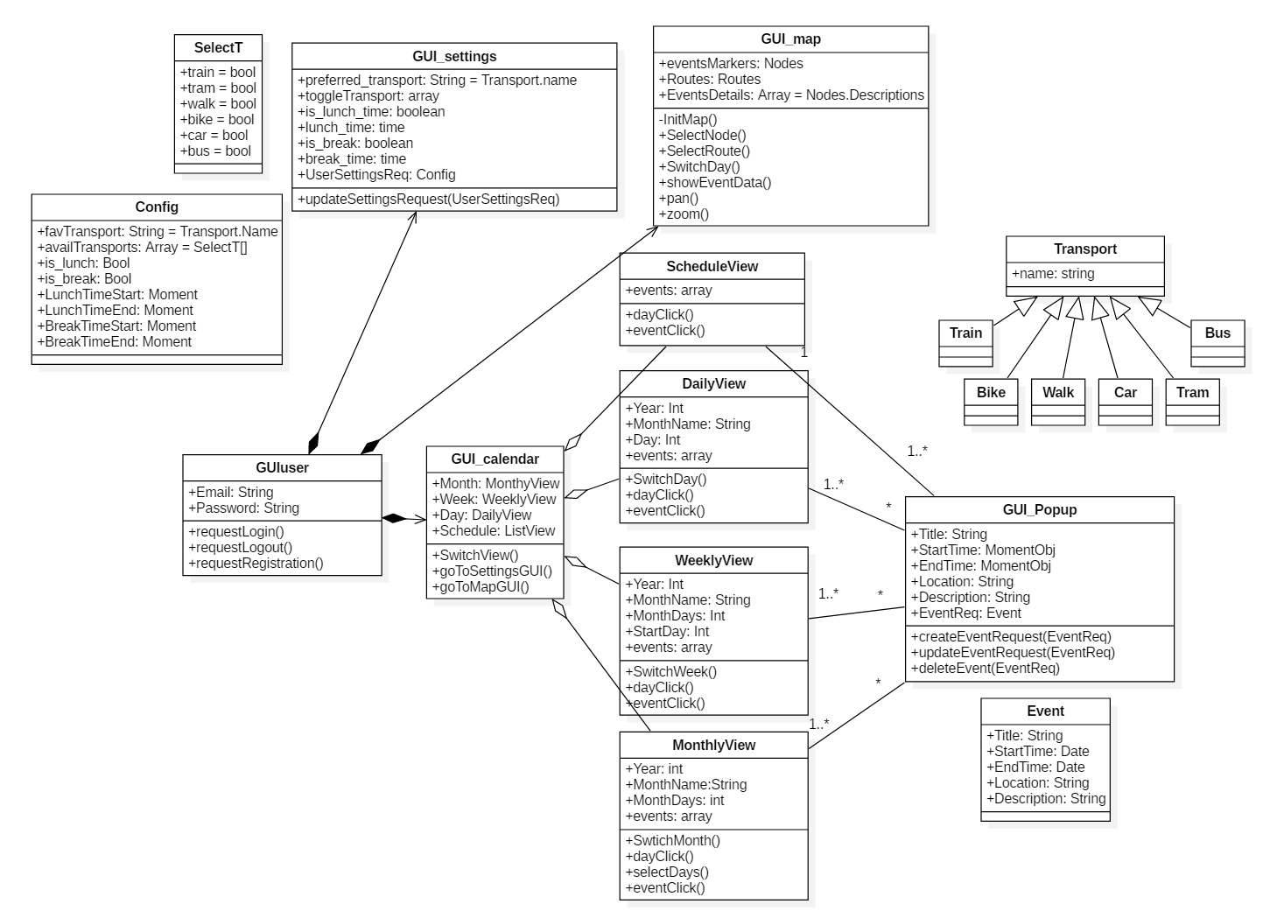
Front End Class Diagram
Design

Slide 19
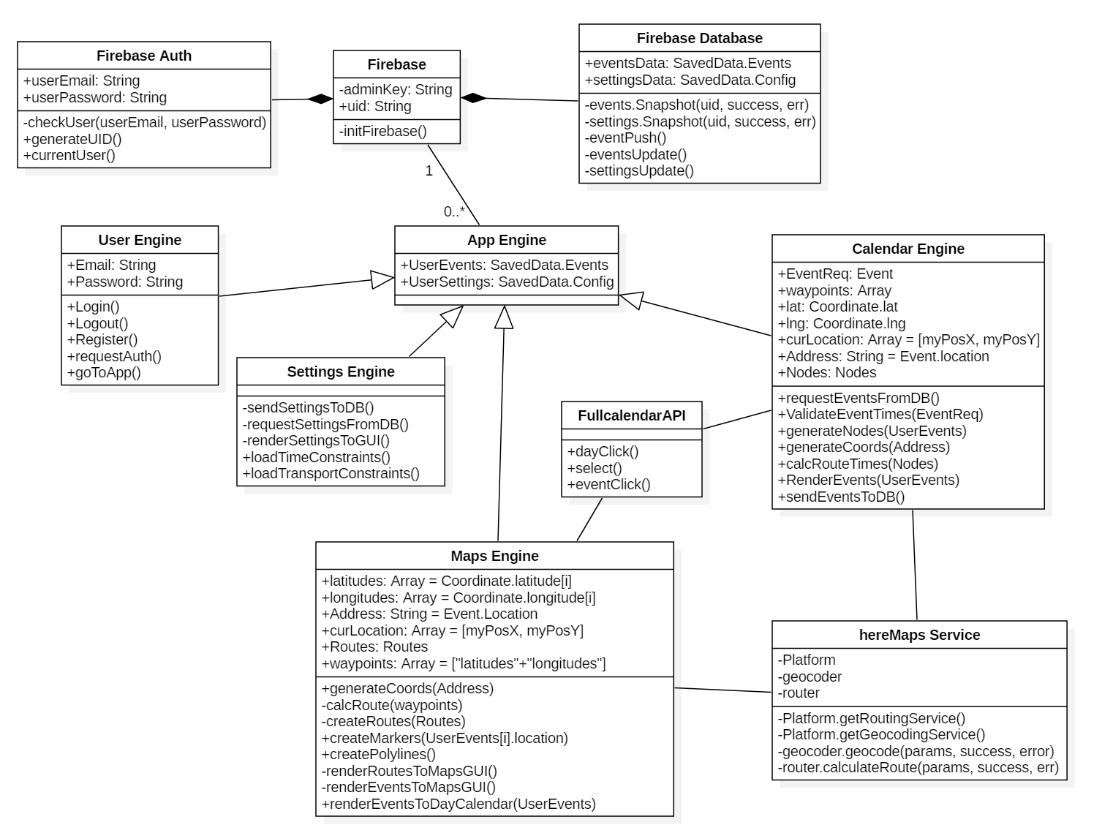
Back End Class Diagram
Design

Slide 20
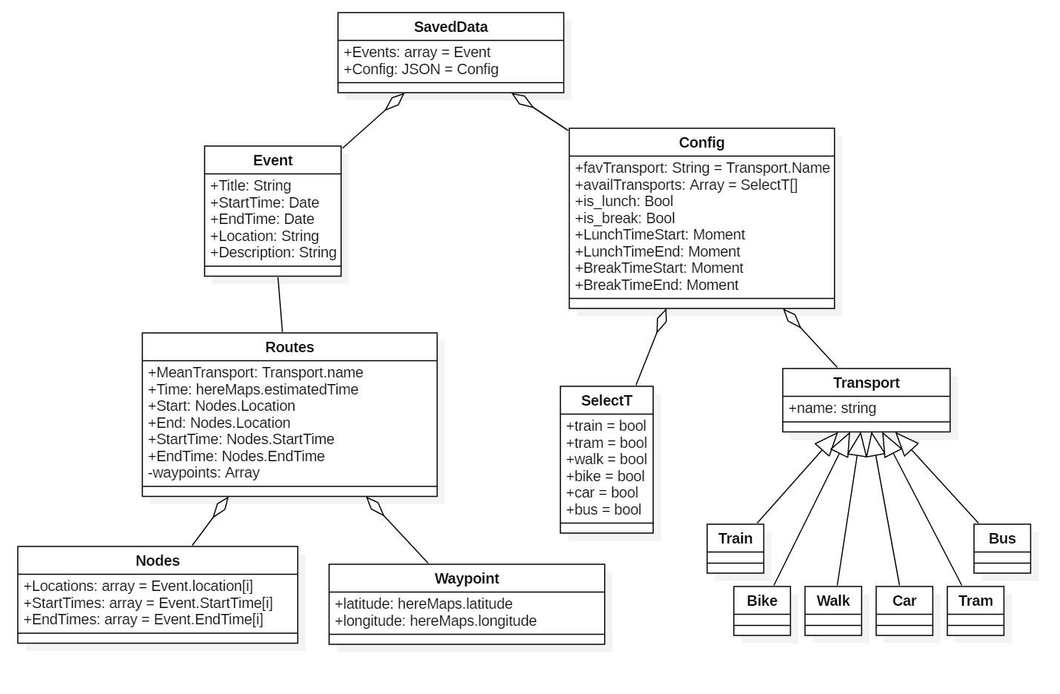
Component Class Diagram
Design

Slide 21
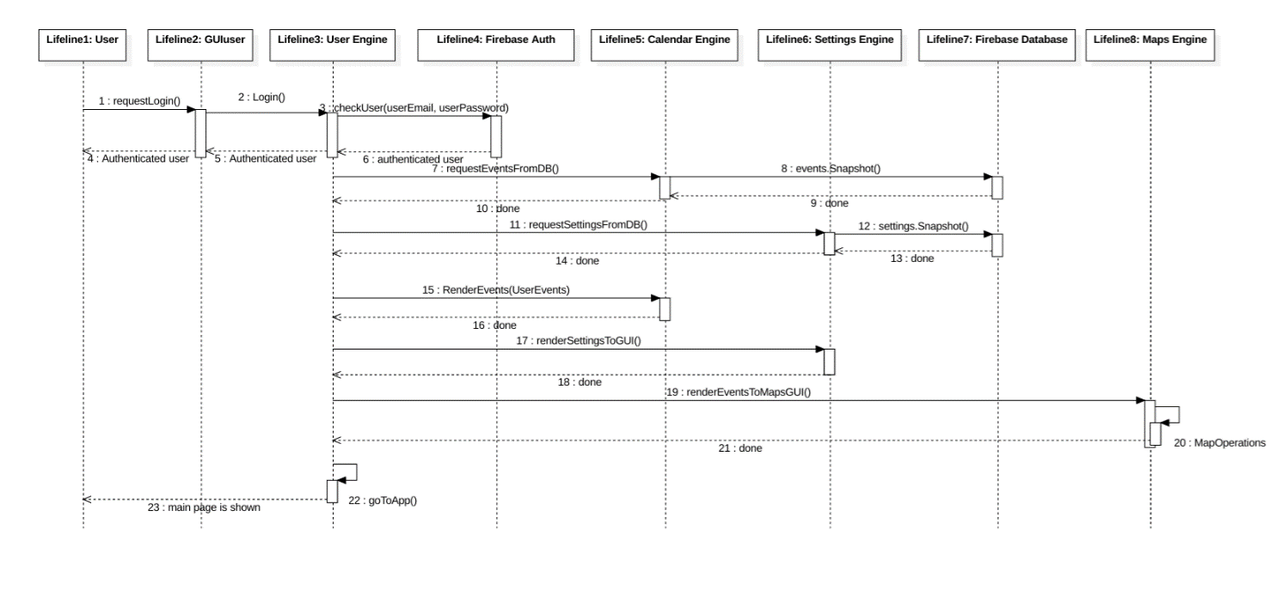
Sequence Diagram: Log in to Web App and load user data to the environment
Design

Slide 22
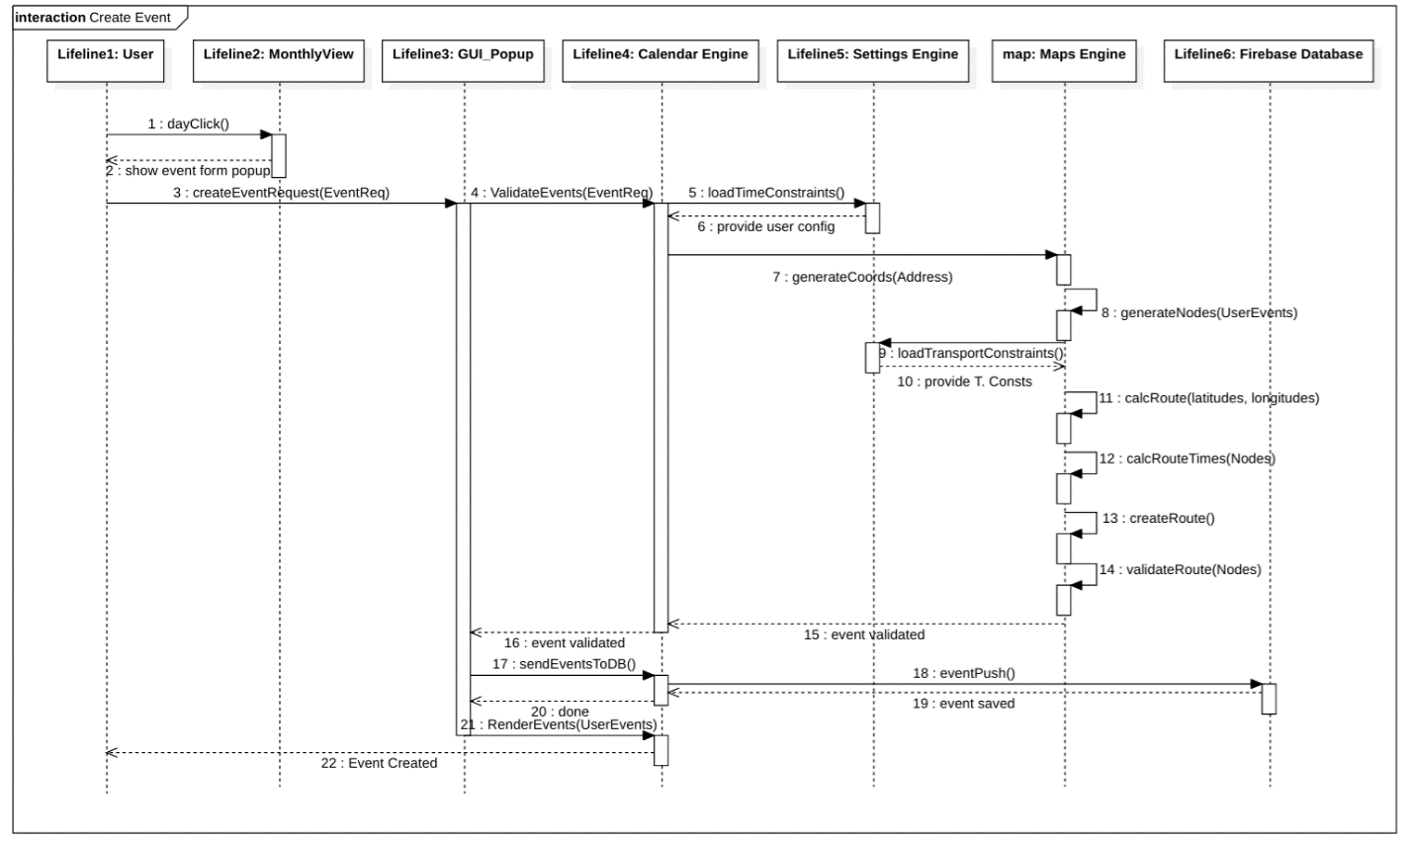
Sequence Diagram: Create an Event
Design

Slide 23
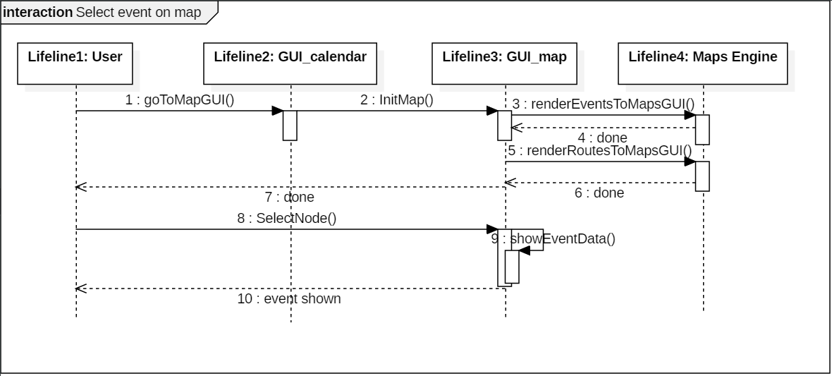
Sequence Diagram: Select an Event on Map
Design

Slide 24
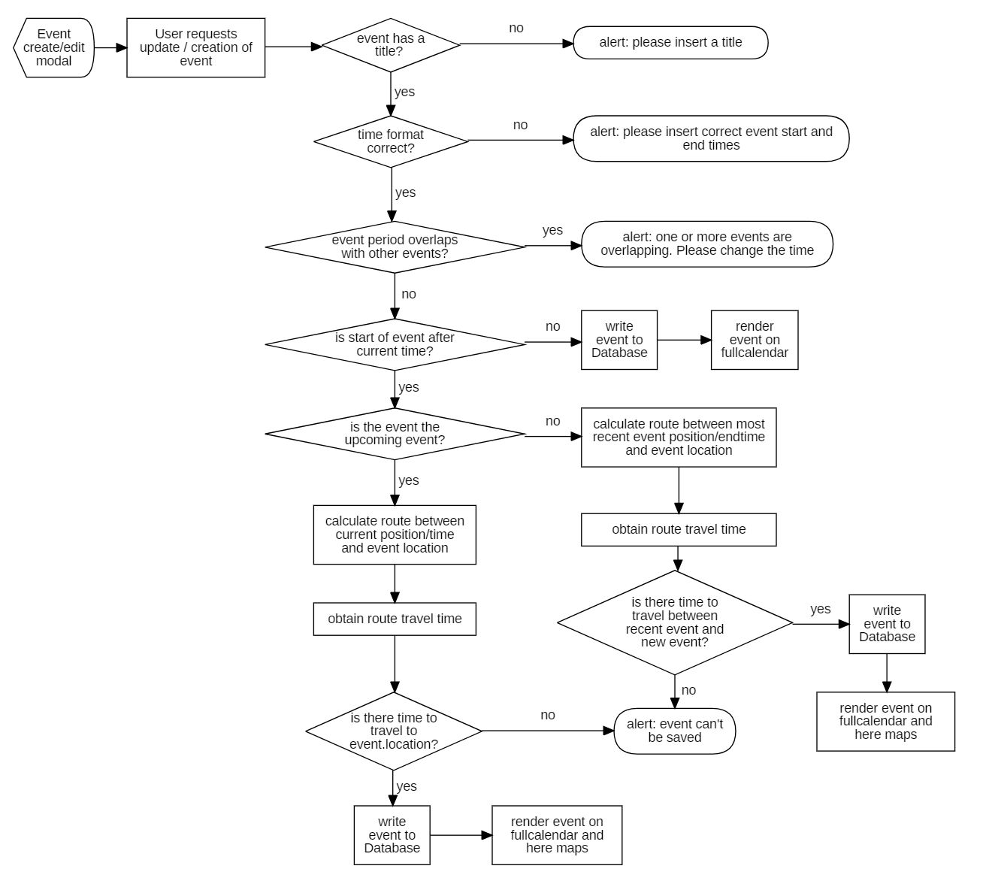
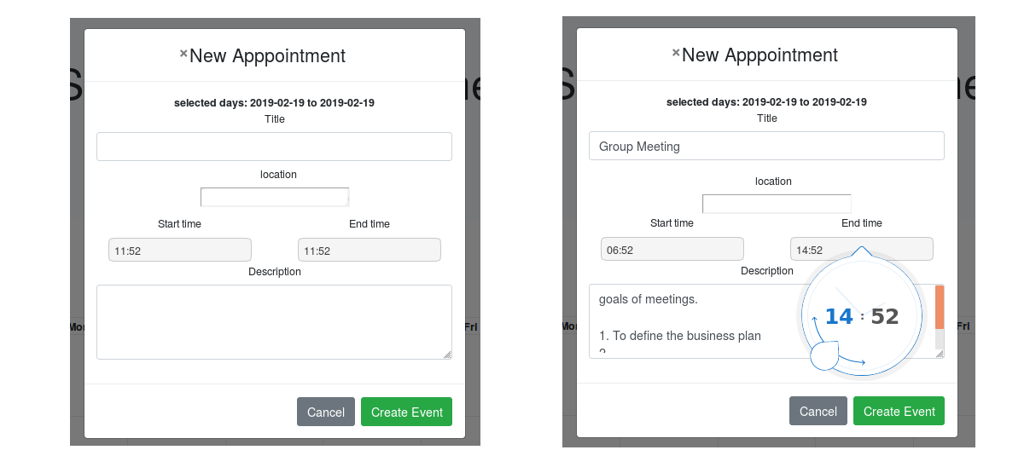
Flow Chart Diagram: Event Creation
Design

Slide 25
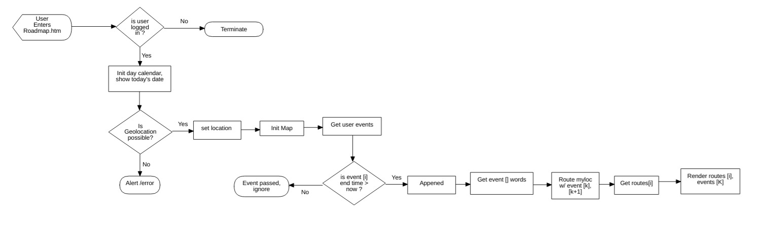
Flow Chart Diagram: Roadmap
Design

Slide 26
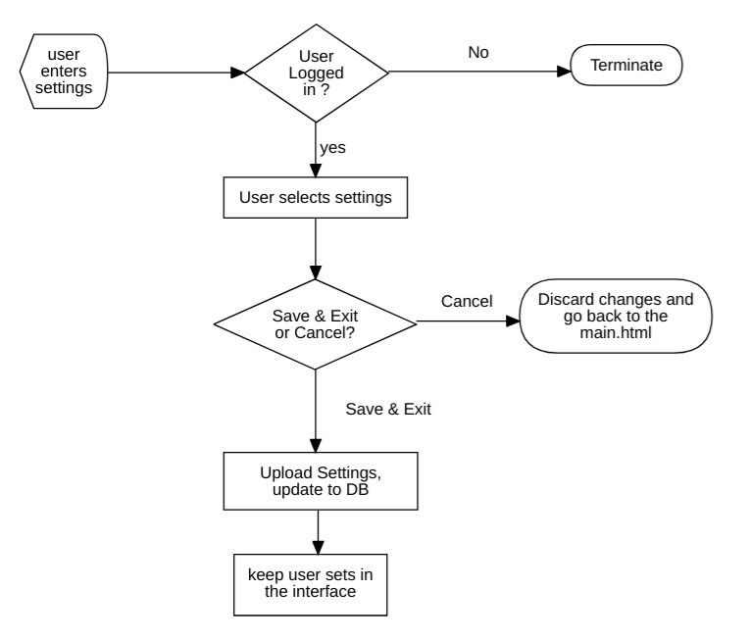
Flow Chart Diagram: Settings
Design

Slide 27
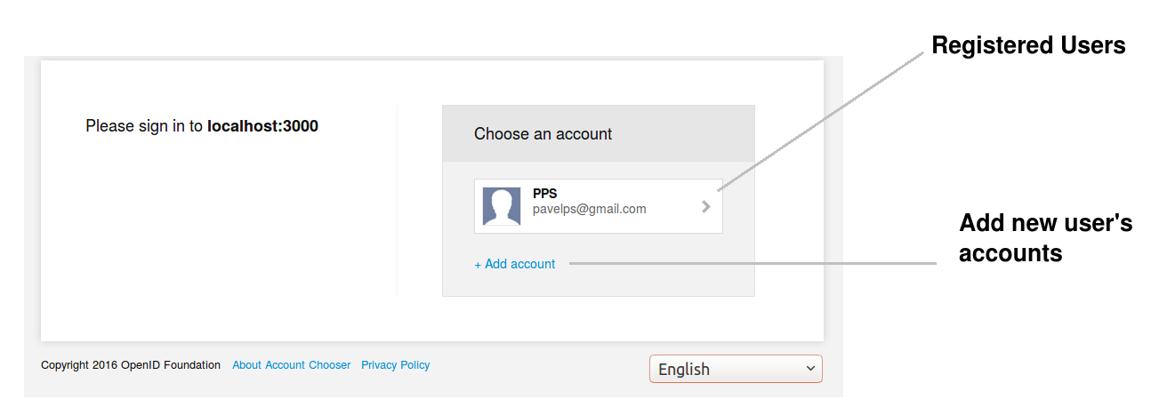
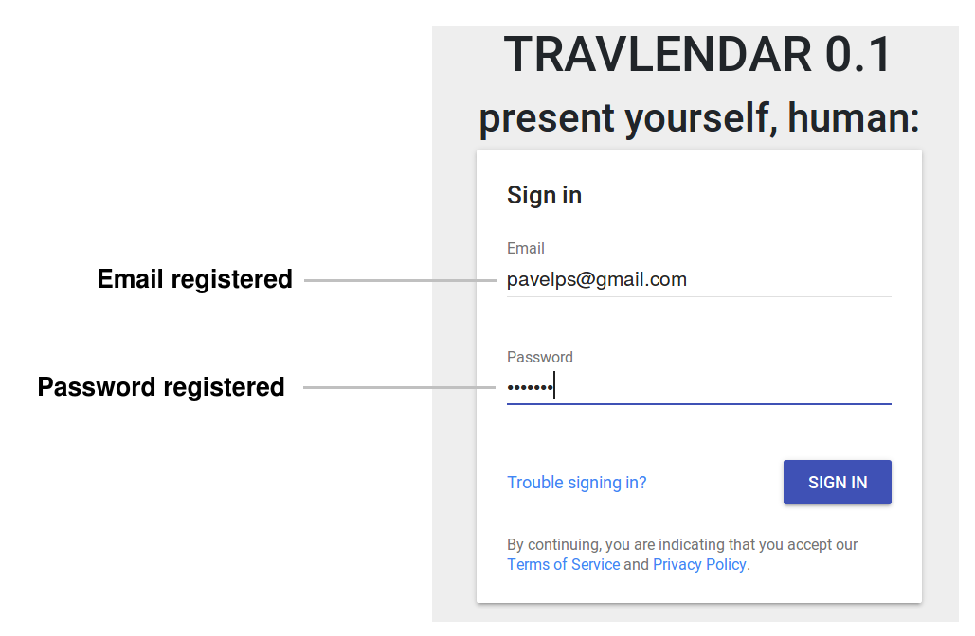
GUI User (Authentication interface)
Implementation

Slide 28
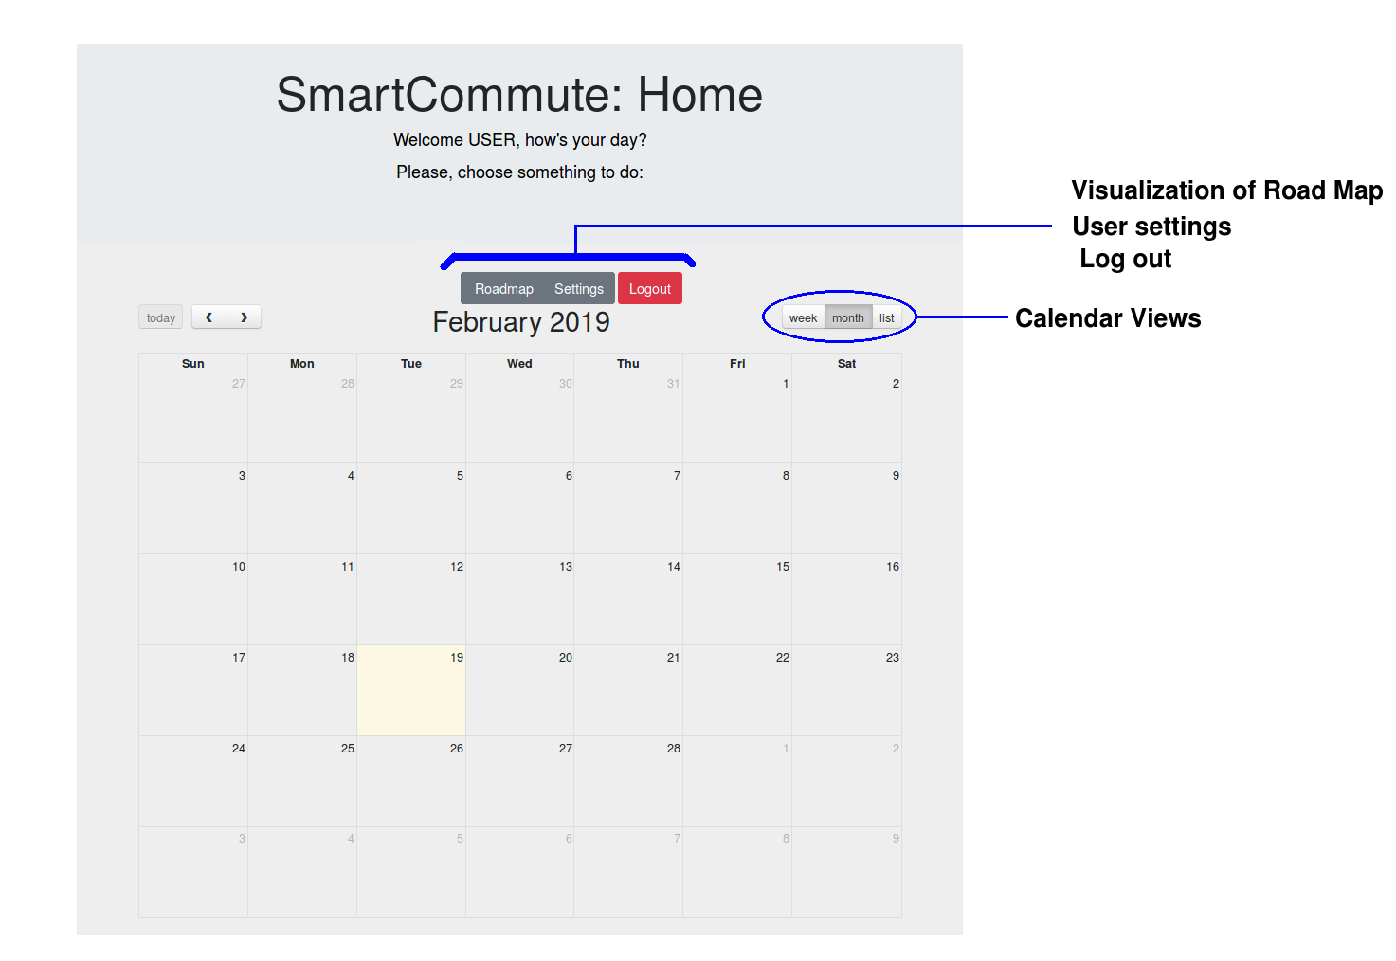
GUI Calendar (Main Page)
Implementation

Slide 29
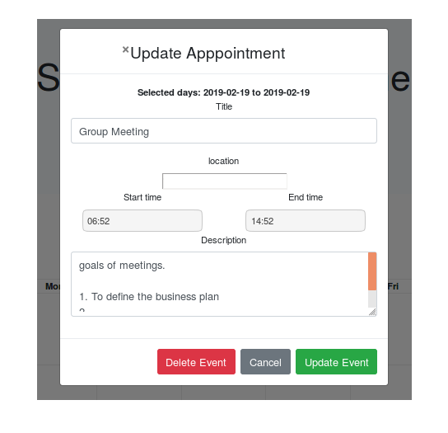
GUI Event Popup
Implementation

Slide 30
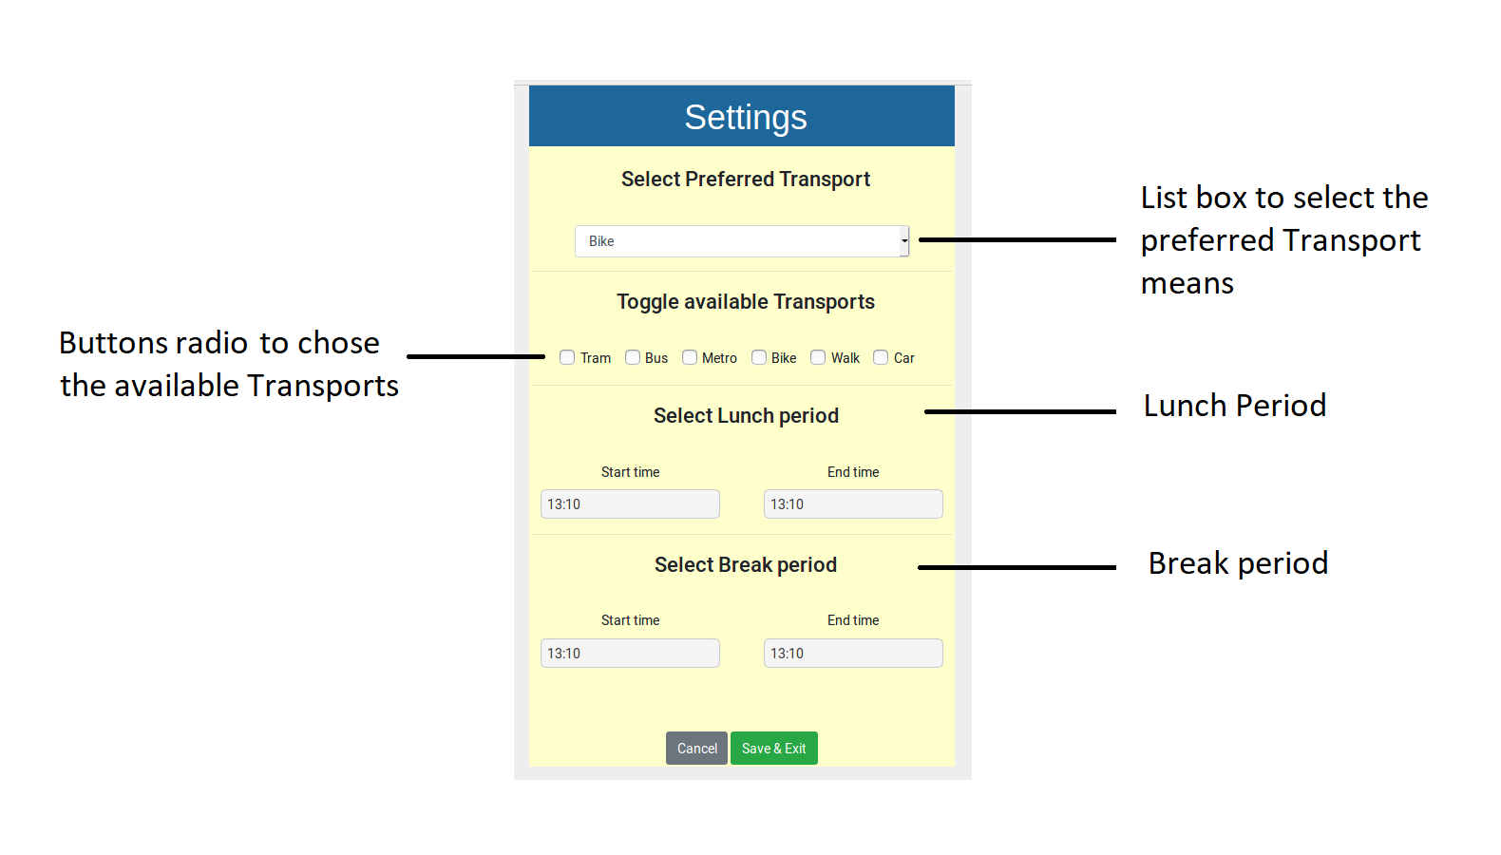
GUI Settings
Implementation

Slide 31
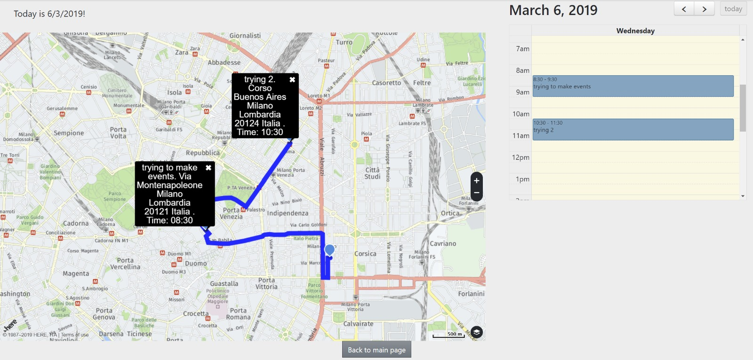
GUI Road Map
Implementation

Slide 32
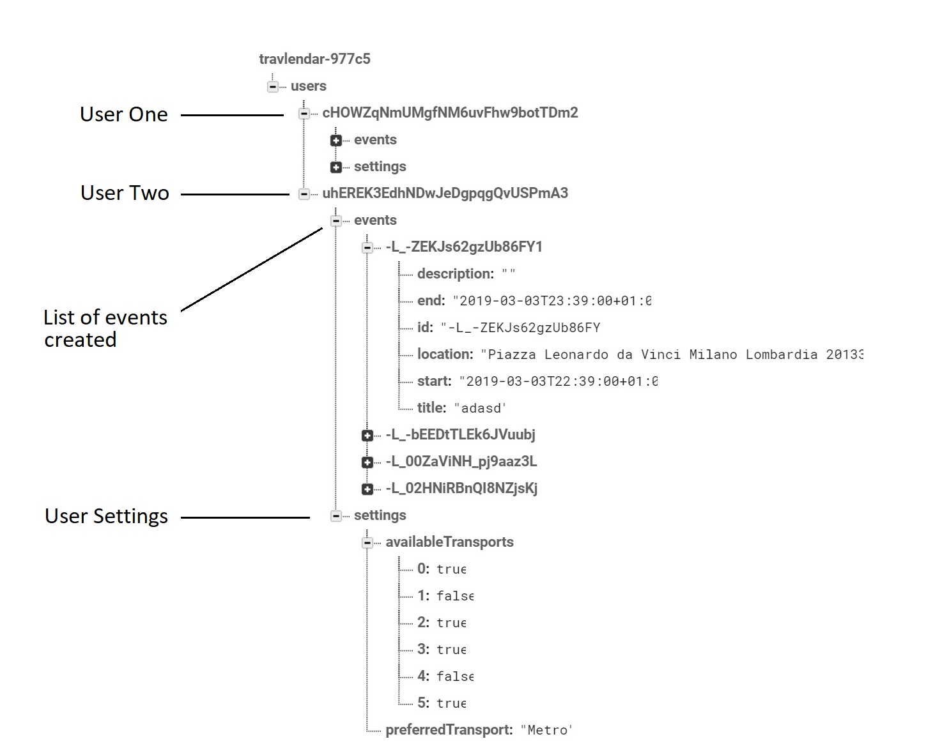
Database (Firebase)
Implementation

Slide 33
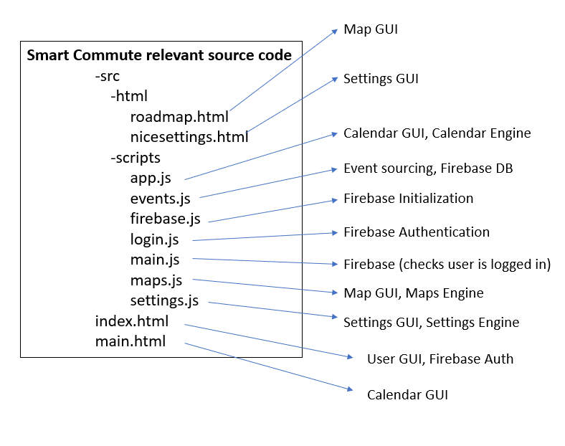
Structure of Web App code
Implementation

Slide 34






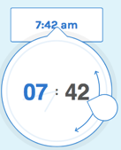

Used Tools
Front End
Back End
Implementation

Slide 35
Testing
Testing

Slide 36
Conclusion and Future work
Conclusion and Future

